Slide 1
Automated Theorem Proving
By-
Rubaan Hasan , 22114080
Parth Patil , 22114065
Pulkit Jain, 22114074
Teredesai Sudharma,22114102
Ojjas Madare , 22114064
Group – 17
B.Tech 3rd year
C.S.E.

Slide 2
Index
Introduction
Concept and Meaning
Origins of ATP
First Implementations
Early Days of ATP
Significance of ATP
Classical Methods
Challenges Involved
Open Problems and Future Scopes

Slide 3
INTRODUCTION
What is Automated Theorem Proving?
Subfield of AI and Mathematical Logic: Focuses on creating programs that prove mathematical theorems automatically.
Main Goal: Develop algorithms and software to find proofs or determine unprovability within a formal system.
Theorem Prover Systems
IMPS (Interactive Mathematical Proof System)
Isabelle
HOL (Higher Order Logic Theorem Proving System)
PVS (Prototype Verification System
TPS (Theorem Prover System))

Slide 4
Concept and Meaning
A theorem is a mathematical statement that is logically derived from axioms basic, self-evident truths.
ATP systems aim to find a proof, which is a sequence of logical steps that confirms the theorem's validity within the system's rules.
Mechanizes reasoning traditionally done by mathematicians.
Verifies mathematical proofs, aids in discovering new theorems, and contributes to software verification and AI.
Automated vs. Interactive Theorem Proving
Automated: System independently derives proofs with minimal human intervention.
Interactive: Combines human guidance with algorithms for efficient proof processes.

Slide 5
Origins of ATP
The roots of Automated Theorem Proving can be traced​ back to the mid-20th century, with the advent of formal logic and the development of the first computers.
John McCarthy(1955): AI pioneer who conceptualized using computers for logical reasoning and coined the term "Artificial Intelligence."
1954
1936
1965
1955
1956
Alan Turing (1936): Introduced the Turing machine, a theoretical model that laid the foundation for modern computing and ATP.
Alan Robinson (1965): Developed the Resolution Principle, enabling automated logical deduction, a key technique in ATP.

Slide 6
First implementations
1954: Martin Davis
Programmed Presburger's algorithm on a JOHNNIAC vacuum-tube computer.
Achievement: Proved that the sum of two even numbers is even.
1954
1936
1965
1955
1956
1956: The Logic Theorist
Developed by Allen Newell, Herbert A. Simon, and J. C. Shaw.
System: Deduction system for propositional logic of Principia Mathematica.
Ran on: JOHNNIAC computer.
Proved 38 of the first 52 theorems of Principia Mathematica using heuristic guidance.

Slide 7
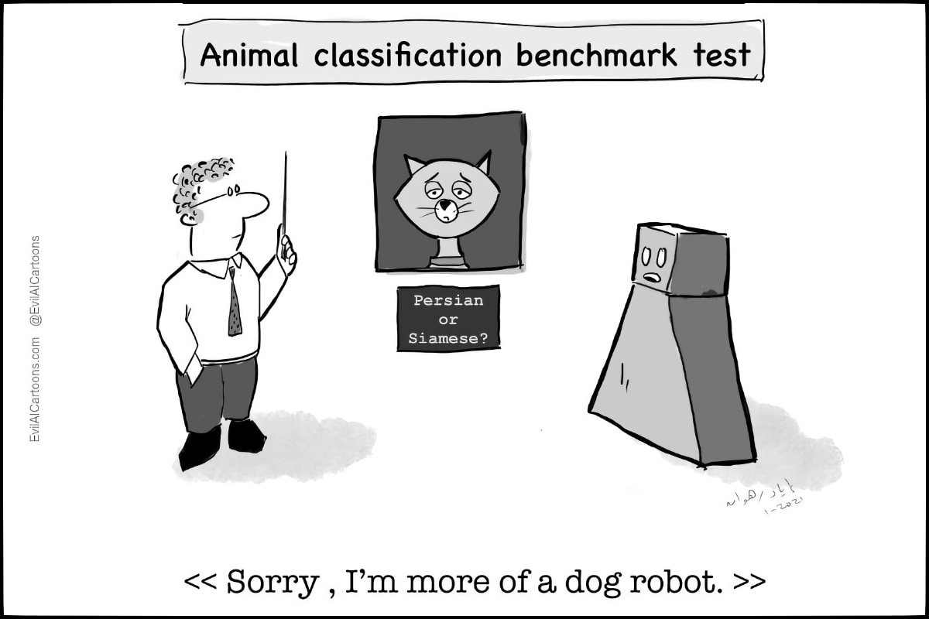
Early Days of ATP
Automated Theorem Proving (ATP) was initially met with skepticism and regarded with caution for several reasons, both technical and philosophical.
Reasons for Initial Disregard:​
Limited Computational Power: In ATP's early days, less powerful computers struggled with hardware limitations, making it challenging to solve moderately complex problems and causing doubts about their practical value.​
Early Failures : Early ATP systems often failed on trivial problems. Its supporters made made ambitious claims about the potential of these systems, which were not met.

Slide 8
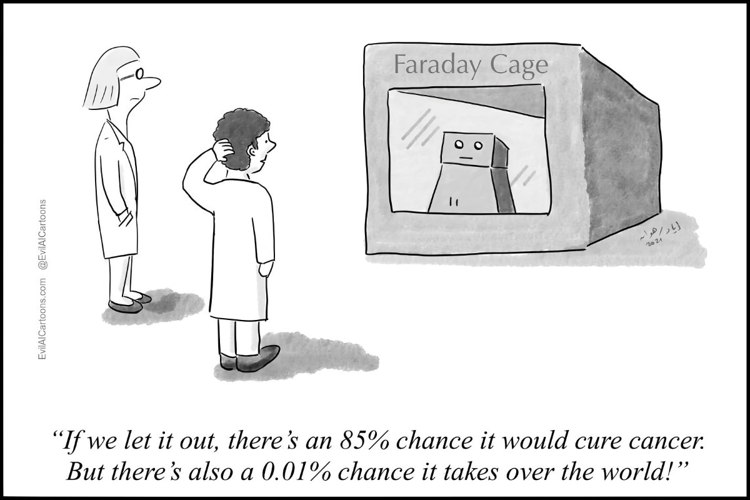
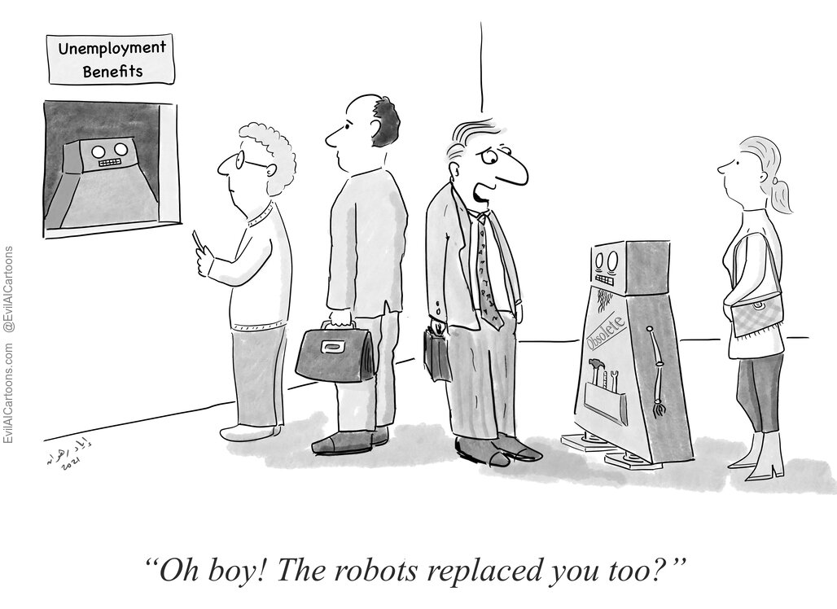
Early Days of ATP
Human Trust : Mathematicians were reluctant to trust proofs generated by machines, particularly because these proofs could not be easily verified by hand and often lacked the intuitive insights provided by human-generated proofs.
Philosophical Concerns : Some saw ATP as reducing the creative and exploratory nature of mathematics to mere computation.
Complexity of Proof Search: Early ATP systems lacked effective heuristics and strategies for guiding the search process, leading to inefficiency and frequent failure in finding proofs for even relatively simple theorems.

Slide 9
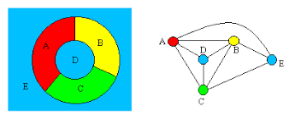
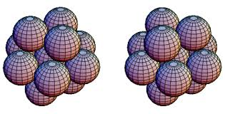
What Proved ATP to Be Important:
Four color map lemma, states that no more than four colors are required to color the regions of any map so that no two adjacent regions have the same color.
Kepler's Conjecture posits that the densest packing of equal-sized spheres in three-dimensional space is achieved through a face-centered cubic or hexagonal close-packed arrangement, with ~74.048% density

Slide 10



What Proved ATP to Be Important:
Francis Guthrie, a student proposed the 4-color problem
Kenneth Appel provided the first accepted proof of 4-color problem using a computer
Conjecture was proposed by Johannes Kepler
Keppler’s conjecture proved by Thomas Hales using computer
Robbins Conjecture proved by ATP. It took 8 continuous days of computing.
Robin proposed algebraic conjecture

Slide 11
Significance of ATP
ATP plays a crucial role in hardware and industry applications, particularly in ensuring the reliability, safety, and correctness of complex systems. Here's an exploration of its significance in these areas:
CompCert Compiler: The formal verification of the CompCert C compiler showed the practical importance of ATP in ensuring the reliability of software, leading to increased industry adoption and trust in these systems.
Formalized Proof Libraries: The creation of formalized proof libraries (e.g., Flyspeck for the Kepler Conjecture) provided a solid foundation for future mathematical work, making proofs more reliable and accessible.

Slide 12

Significance of ATP
Cryptography
ATP is used to formally verify that SSL/TLS or secure multi-party computation protocols behave correctly under all possible conditions.
ATP is used to automatically explore potential attack vectors and verify whether a system is vulnerable to known types of cryptographic attacks.
ATP can verify the security of post-quantum cryptographic algorithms, ensuring they resist quantum attacks
In General, Automated theorem proving is often used in areas where there is a need to verify a large number of cases or where the complexity of the problem Is beyond human capacity to manually verify.

Slide 13
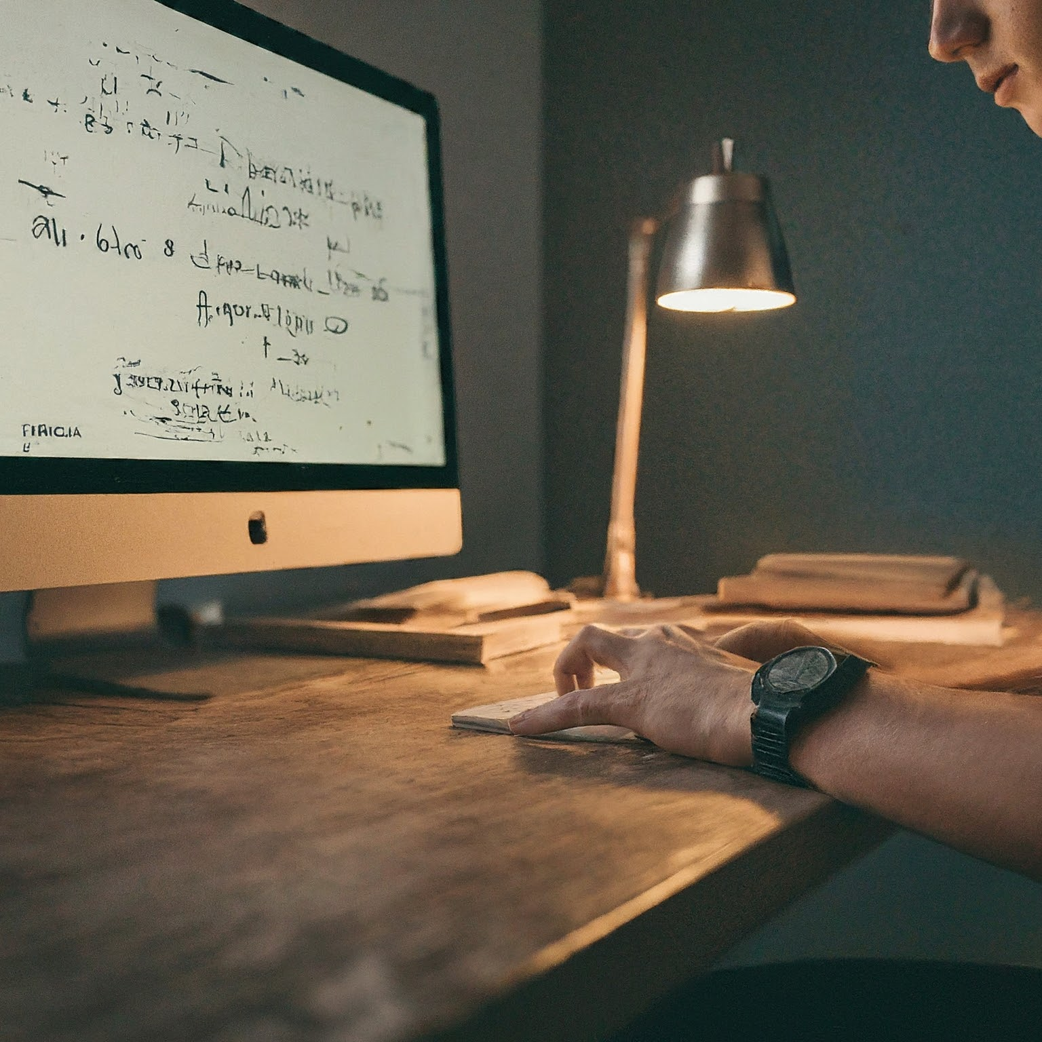
Exploring Various Approaches in ATP
Classical Methods​
use of logic and deduction rules​
Forming the foundation of ATP ​
Modern Techniques ​
Advanced Algorithms​
computational strategies ​
enhance efficiency and accuracy​
Interactive Theorem Provers​
Interactively construct and verify proofs​
Combining human insight ​
AI/ML Based Methods​
Integration of AI/ML ​
enables autonomous learning and adaptation​
Improving theorem proving capabilities.

Slide 14
Classical Methods
Classical methods form the foundation of ATP, relying on logical reasoning techniques to prove or disprove theorems.
EXAMPLE
If it rains, then the ground will be wet
It is raining
The ground is wet
Steps :​
Identify the set of statements given. ​
Convert to Boolean Algebraic Expressions.
Convert these expressions to CNF form.
Negate the theorem & add it to set of clauses
Resolution-Based Systems
Apply the Resolution Rule.
Deduce the Contradiction,
and Conclude the Proof .
Premise 1
Premise 2
To Prove
𝑃→𝑄
𝑃
𝑄
¬𝑃∨𝑄
𝑃
𝑄
¬𝑃∨𝑄 , 𝑃 , ¬ 𝑄
𝑄 , ¬ 𝑄
CONTRADICTON
HENCE PROVED

Slide 15
Transition to Modern Techniques
While classical methods have been invaluable, modern techniques like SAT and SMT solvers offer more power and scalability for complex problems.
SAT solver
The SAT problem is a decision problem that asks whether there exists an assignment of truth values to variables that makes a given Boolean formula true.
Key Techniques in SAT Solvers:​
Unit Propagation: If a clause contains only one literal, that literal must be true for the clause to be satisfied. This can simplify the problem.​
Pure Literal Elimination: If a literal appears in the formula without its negation, it can be assigned a truth value that makes the formula true.​
Backjumping: the solver can "jump" back to the most recent decision that is relevant to the conflict.​
​
​
SOLUTION
Start
NOT A SOLUTION
SOLUTION
END

Slide 16
Transition to Modern Techniques
SMT solver (Satisfiability Modulo a Theory)
SMT extends SAT by adding the ability to handle formulas with respect to various theories that includes Arithmetic, Arrays, Bit-Vectors, Linear Inequalities, and more.
Consider a formula with arithmetic expressions: (x>5) ∧ (y=x+3) ∧ (z<y)
SMT solvers combine techniques from SAT solving with specialized solvers for various theories.
SMT solvers typically operates in 2 phases:​
SAT Solving Phase: first tries to find a Boolean assignment that could potentially satisfy the formula by abstracting the non-Boolean components.​
Theory Solving Phase: Once a candidate Boolean assignment is found, the solver checks whether the assignment is consistent. If the assignment is valid according to the theories, the formula is satisfiable. If not, the solver refines the problem and continues the search.

Slide 17
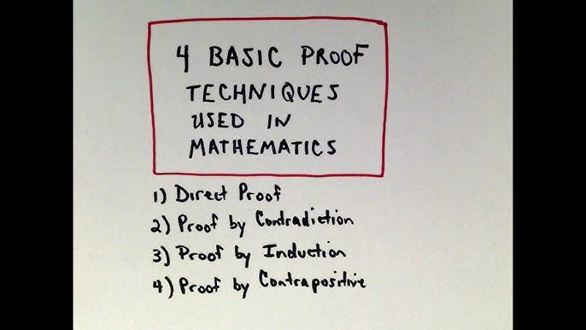
Interactive Theorem Provers
Interactive Theorem Provers (ITPs) are a class of software tools designed to assist in the development of formal proofs by enabling a collaborative approach between human users and machines.
DIFFICULTY FOR ATPs: DOESN'T KNOW WHICH PATH TO TAKE
Features provided by ITPs
The primary goal of ITPs is to ensure that complex mathematical proofs or verification tasks are carried out with high accuracy by leveraging both human intuition and machine precision.
Users guide the proof process by providing insights, strategies, and intermediate steps, while the software automatically checks each step for logical correctness.
Users bring creativity, insight, pattern recognition and understanding of the broader context, which is essential for tackling complex and novel problems.

Slide 18
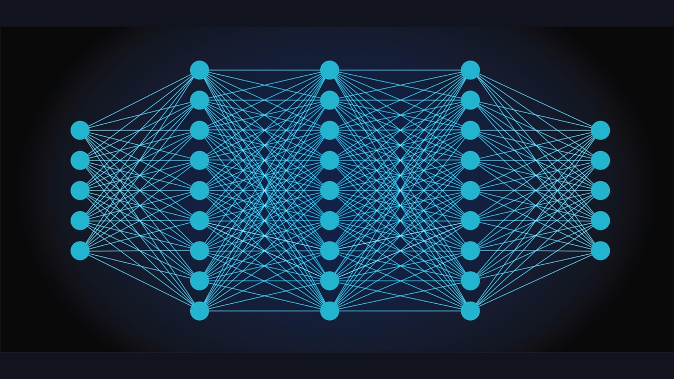
AI/ML-Based Methods in ATP
Artificial Intelligence (AI) and Machine Learning (ML) are being integrated into ATP systems .
By using Neural Networks, we can predict the most suitable proof strategy for a given problem, helping to avoid the combinatorial explosion that often occurs in ATP.
Trained on a large set of ATP problems and solutions.
Learns patterns and keywords associated with different problem types and solution strategies.
For example, problems with logical implications might be directed towards resolution or tableau methods, while problems involving mathematical sequences might be handled using mathematical induction.
Input layer: Receives the initial data(images,numbers,etc).
Hidden layers: Process and learn patterns from the input, adjusting weights to improve accuracy.
Output layer: Produces the final result, telling the probablity for all the ATP methods. Number of nodes = Methods in ATP

Slide 19

Challenges Involved
Automated Theorem Proving involves proving broad category of problems in which each can have a different approach of solving.
Also, there are some typical problems which have a unique/innovative solution.
Accounting these makes the process of creating an ATP software a tough job.
Some of the Challenges are :
1) Complexity in Interpretation
2) Combinatorial Explosion
3) Resource Constraints
4) Implementing Parallelism
5) Overfitting
6) Accessibility for Non-Experts
7) Gap between Human and Machine Reasoning
8) Visualization of Proofs

Slide 20

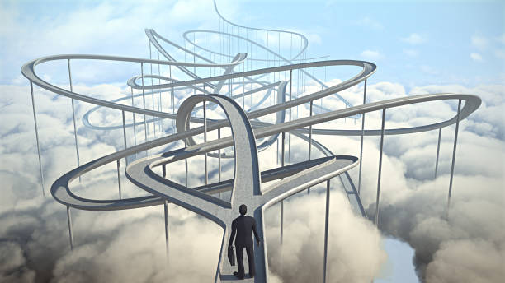
Challenges Involved
1) Complexity in Interpretation :
Questions can be framed in a language whose interpretation can also be tough.
Sometimes extra information is given which is not at all used in the problem.
Managing the complexity of the inference process and avoiding redundant or irrelevant consequences is a significant challenge.
2) Combinatorial Explosion :
The number of potential sequences of steps / proof strategies can be very large for problems , making it difficult to find proofs efficiently.
Trying all possible methods is not a feasible solution.

Slide 21

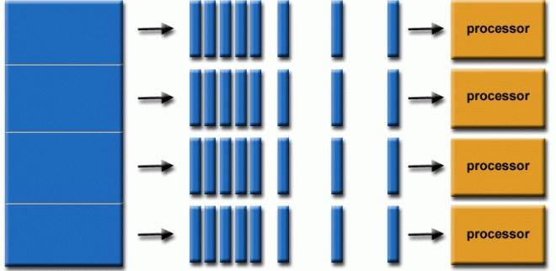
Challenges Involved
3) Resource Constraints :
ATP systems require significant computational resources, especially for complex problems, limiting their scalability.
This refer to the limitations on computational resources— such as time, memory, and processing power which affect performance of the system.
4) Implementing Parallelism :
High time required for processing can be reduced by introducing parallelism.
But, effectively parallelizing the search for proofs without redundancy or loss of efficiency is non-trivial.
Some parts must be executed sequentially which bottleneck this.

Slide 22
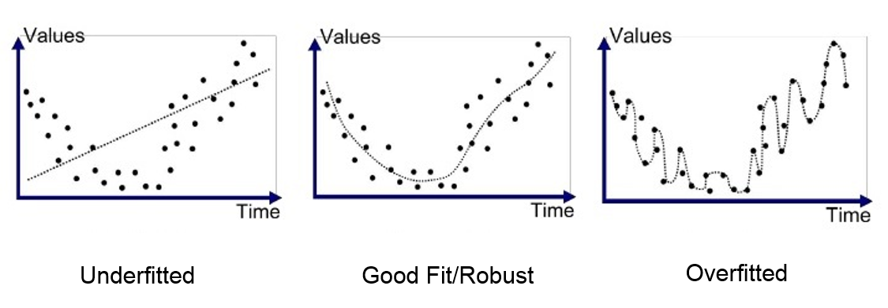

Challenges Involved
5) Overfitting :
Heuristics that work well on specific problems may fail on others, leading to inconsistent performance.
If our ATP system can't figure out which heuristic is applicable on which problem then it won't be able to solve other problems apart from the ones which are fed to it(known as Overfitting).
6) Accessibility for Non-Experts :
ATP systems often require deep knowledge of Logic and Formal methods, Mathematics, Coding, Neural Networks making them less accessible to non-experts.
To train such systems, we need experts from several fields : Mathematics, Proving , Computer Science , Machine Learning , etc.

Slide 23
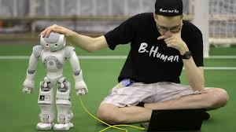

Challenges Involved
7) Gap between Human and Machine Reasoning:
Human mathematicians use intuition and experience to guide their reasoning, while ATP systems lack this ability, leading to difficulties in solving problems that require creative insights.
This is an ongoing challenge.
8) Visualization of Proofs:
Even if our software figures out a proof , Presenting proofs in a way that is understandable and useful to human users, especially in complex domains, remains a challenge.
Among multiple ways of visualization , one needs to be selected according to personalization of the user

Slide 24
Open Problems and Future Scopes
Scalability and Computational Complexity​
The computational complexity of many theorem-proving ​algorithms grows exponentially with the size of the problem.​
The challenge lies in managing the combinatorial explosion inherent in first-order logic (FOL) and higher - order logics (HOL).​
Machine Learning Integration for Heuristic Guidance
While symbolic approaches are powerful, they often lack the flexibility to adapt to new types of problems.
The challenge is to design models that can reason over symbolic structures like graphs or trees.
First-order logic (FOL)
Higher-order logic (HOL)
Quantifies over individuals (objects)
Quantifies over individuals and predicates/functions.

Slide 25
Open Problems and Future Scopes
Handling Incompleteness and Uncertainty in Logic​
ATP systems traditionally assume complete and consistent information, which is not always available in real-world scenarios
Human-Computer Collaboration in Interactive Theorem Proving (ITP)
Interactive Theorem Provers require extensive user input to guide the proof process.
Developing Theorem Provers that can -
Enhancing Proof Assistants
Operate under Paraconsistent Logic and non-monotonic Logic
Incorporate probabilistic logic or fuzzy logic
Coq
Isabelle/HOL
Lean

Slide 26
Open Problems and Future Scopes
Advances in Proof Search Algorithms
Developing new proof search algorithms that can efficiently navigate large search spaces.
Integration with Other AI and Formal Methods
ATP systems often work in isolation, limiting their applicability in broader AI systems or in conjunction with other formal methods.
Refinable Promising Techniques
Integrating ATP Systems with :-
Conflict-Driven Clause Learning (CDCL)
Model checking
symbolic execution engines
Satisfiability Modulo Theories (SMT)
abstract interpretation

Slide 27
Open Problems and Future Scopes
Advanced Proof Visualization and Explanation Tools
Creating tools that make machine-generated proofs more understandable to humans, particularly for educational and verification purposes.
Developing proof visualization systems that can render proofs as interactive diagrams or structured trees, highlighting the logical flow and critical steps.
Ethical Implications and Trustworthiness of ATP
As ATP systems are increasingly used in critical applications, ensuring their ethical use and reliability becomes paramount.
ATP requires ethical trustworthiness in fields like :-
Healthcare
Financial Services
Legal Systems
Autonomous Vehicles
Satisfiability Modulo Theories (SMT)

Slide 28
Bibliography
https://en.wikipedia.org/wiki/Automated_theorem_proving#:~:text=Automated%20theorem%20proving%20(also%20known,the%20development%20of%20computer%20science.
https://www.cs.cmu.edu/~fp/courses/atp/handouts/atp.pdf
https://www.quantamagazine.org/how-close-are-computers-to-automating-mathematical-reasoning-20200827/
https://paperswithcode.com/task/automated-theorem-proving
https://www.sciencedirect.com/topics/computer-science/automated-theorem-proving

Slide 29
THANK YOU

